Slide 1
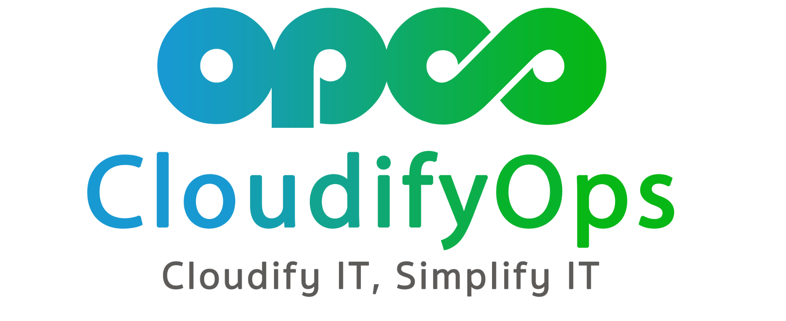

Canary Deployment with Argo Rollouts
]

Slide 2

Canary Deployment with Argo Rollouts
Mohan Babu. D

Slide 3
AGENDA
Canary Deployment Understanding the concept and benefits.
Argo Rollouts Introduction to the tool and its key features.
Demo

Slide 4

Canary Deployment
Canary deployment is a software release strategy that involves
gradually rolling out a new version to a small subset of users,
known as the "canaries." The term “canary deployment” comes from an old coal mining
technique. Canaries are more sensitive to airborne toxins such
as CO than humans, so miners would use them as early
detectors.

Slide 5
Benefits of Canary Deployment
A/B Testing: We present two alternatives to the users and see which gets better reception.
Capacity testing: Any performance issues we have in our system will begin to crop up as we slowly migrate the users to the canary.
Easy rollbacks: If something goes wrong, we can easily roll back to the previous version.
Zero Downtime: Like blue-green deployments, a canary deployment doesn’t generate downtime.

Slide 6
Limitations of Canary Deployment
Limited Testing Scenarios: Canary deployments are effective for catching certain types of bugs but might miss issues related to heavy load, data migration.
Observability: canary deployments requires visibility of user behavior, system and application issues, to measure the relevant metrics and determine if the canary test is a success.
Complexity: When we try to modify the application to interact with the database or change the database Schema, we end up with a very complex deployment process.

Slide 7
ARGO ROLLOUTS
Argo Rollouts is a Kubernetes Controller and set of Custom Resource Definitions (CRDs) that provide advanced features for application deployment on Kubernetes compared to the native Kubernetes Deployment Object.
Argo Rollouts provide deployment capabilities such as blue-green, canary, canary analysis, experimentation, and progressive delivery features to Kubernetes.

Slide 8
Key Features of Argo Rollouts
Rollout Strategies: Blue-Green, Canary, and AB Testing.
Traffic Shifting: Gradual transition between versions.
Rollback Capabilities: Quick and automated rollback in case of issues.
Metrics and Monitoring: Prometheus and Grafana integration.
Web UI: User-friendly interface for deployment visualization.
Notifications: Integration with notification systems.

Slide 9
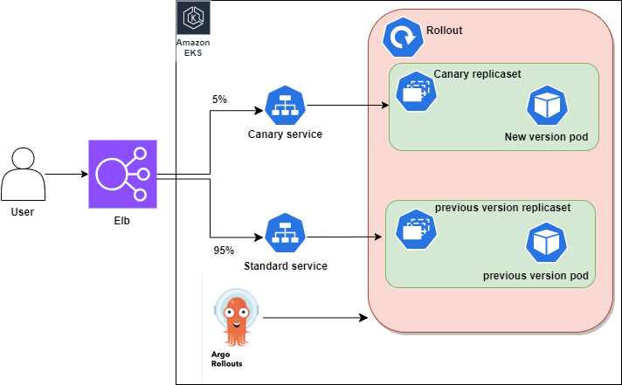
Architecture Diagram

Slide 10
Reference Links
Solution Approach
Runbook

Slide 11


Slide 12

THANK YOU
mohanbabu@cloudifyops.com

